Slide 1
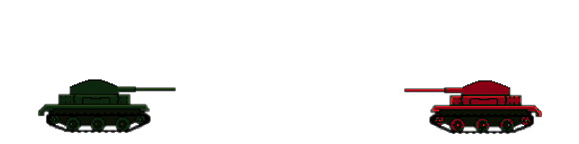
Bunker Busters
By: Ryan “Bob” Dean

Slide 2
Objective
Destroy the enemy tanks
Tanks take damage from explosions and falling
Shot angle (90 degrees, around top of tank) and velocity are decided before shooting
Different weapons specialize in different tactics (dirt remover, dirt creator, bigger explosions, etc.)

Slide 3
Obstacles
Shots will be affected by terrain, gravity, and wind
Terrain will be destructible, and will fall due to gravity
Procedurally generated terrain is a goal, but demo might have static terrain layouts
Balloons or aircraft will hover in the air blocking shots; they will move between turns or during shots

Slide 4
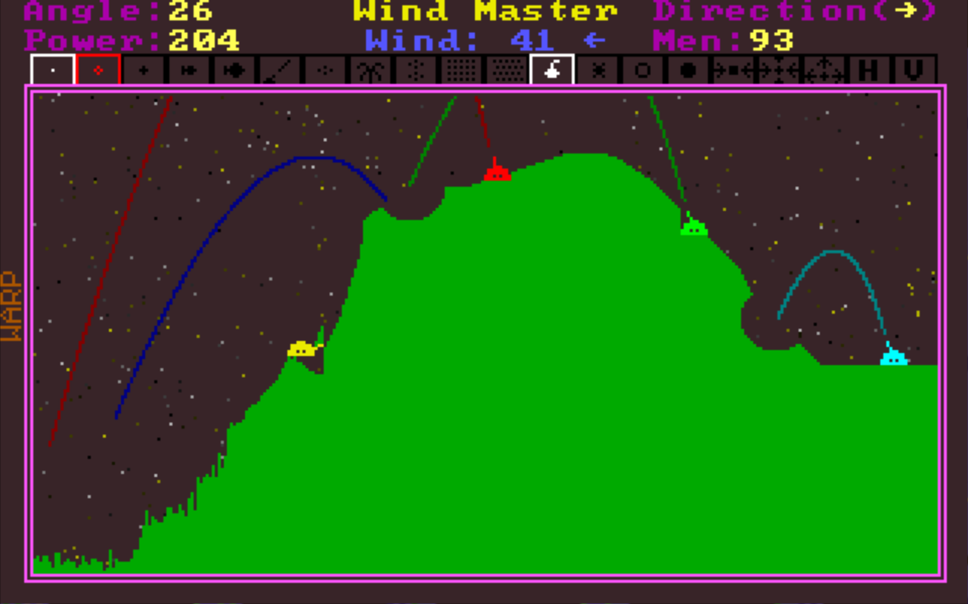
Inspiration
Tank Wars (1990)

